Slide 1





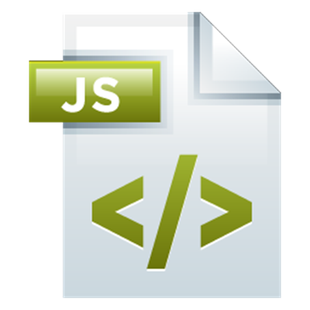
Routing and Patterns
Browser Routing
Design Patterns in JS
Routing
SoftUni Team
Technical Trainers
Software University
http://softuni.bg

Slide 2


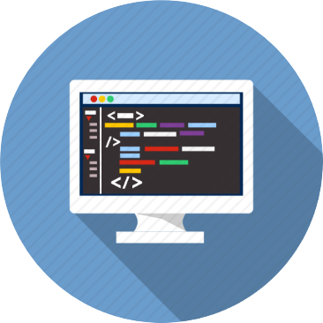
Table of Contents
Routing Concepts
Basic Router
Sammy.js Overview
Design Patterns
1

Slide 3
Have a Question?
sli.do #JSAPPS
1

Slide 4
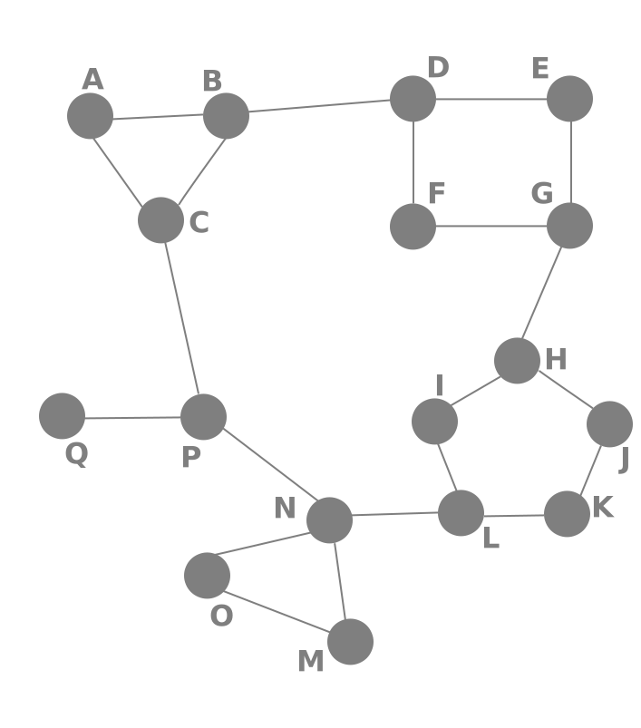
Routing Concepts
Navigation for Single Page Apps

Slide 5

What is Routing?
Routing allows navigation, without reloading the page
It's a pivotal element of writing Single Page Applications
Link
HTML
Router
Link
Link
Link
Standard Navigation
Navigation using Routing
1

Slide 6
How Routers Work
A Router loads the appropriate content when the location changes
E.g. when the user manually enters an address
Conversely, a change in content is reflected in the address bar
E.g. when the user clicks on a link
Benefits:
Load all scripts only once
Maintain state across multiple pages
Browser history can be used
Build User Interfaces that react quickly
1

Slide 7

Live Demo
Writing a Simple Browser Router

Slide 8
Routing with Sammy.js
Overview and Examples

Slide 9
Sammy.js Overview
Sammy is a lightweight routing library
Modular design with plugins and adapters
Requires with jQuery
Many additional features
const app = Sammy('#main', function() {
this.get('index.html', () => {
this.swap('Index');
})
});
1

Slide 10
Installation
Download Sammy using WebStorm's terminal
Or download from sammyjs.org
Browser builds will be located in:
Sammy requires jQuery to work!
npm install --save sammy
node_modules/sammy/lib/
Note: It's best if your project has a package.json file
1

Slide 11
Hello Sammy
index.html
<!DOCTYPE html>
<head>
<meta charset="UTF-8">
<title>Hello Sammy</title>
<!-- Include jQuery and Sammy distributions -->
</head>
<body>
<header>
<h1>Hello Sammy</h1>
<a href="index.html">Home</a>
<a href="about">About</a>
<a href="contact">Contact</a>
</header>
<div id="main"></div>
</body>
</html>
1

Slide 12
Hello Sammy (2)
app.js
const app = Sammy('#main', function () {
this.get('index.html', () => {
this.swap('<h2>Home Page</h2>');
});
this.get('about', () => {
this.swap('<h2>About Page</h2>');
});
this.get('contact', () => {
this.swap('<h2>Contact Page</h2>');
});
});
$(() => {
app.run();
});
1

Slide 13
Application Initialization
Create a Sammy instance to initialize your application
You may have multiple apps running
Each selector can only hold one app
If you refer to it again, it extends the functionality
Invoke library
Element selector
const app = Sammy('#main', function () {
// Define routes and other logic here
});
$(() => app.run()); // Activate
1

Slide 14
Creating Routes
The main building block of Sammy is the route
Defined by method and address (URI)
Place this block inside a Sammy initializer:
A note on using this: it holds a reference to the router object, but may not work correctly in an arrow function
Route Method
Route address
this.route('get', 'about', function() {
this.swap('<h2>Contact Page</h2>');
});
1

Slide 15
Route Aliases
Each method has an alias for shorter code
this.get('catalog', loadBooks)
this.post('login', userLogin)
this.put('catalog/:bookId', updateBook)
this.del('catalog/:bookId', deleteBook)
1

Slide 16
URL Parameters
Parameters allow for dynamic routes
E.g. products in a catalog will load the same page
You can get the whole path using this.path
Parameter name
Receive context
this.get('catalog/:productId', (context) => {
console.log(context.params.productId);
});
Access passed in value
1

Slide 17
Handling Forms
Forms inside the main element are automatically handled
Route address
Route method
<form action="login" method="post">
User: <input name="user" type="text">
Pass: <input name="pass" type="password">
<input type="submit" value="Login">
</form>
this.post('login', (context) => {
console.log(context.params.user);
console.log(context.params.pass);
});
Names of inputs
1

Slide 18
Integrating Handlebars
Download and include the Handlebars source in your HTML
Include sammy.handlebars.js (found under lib/plugins)
Load the plugin inside a Sammy initializer:
Create a RenderContext with render, load or partial
this.use('Handlebars', 'hbr');
Template file extension
1

Slide 19
Using Handlebars
greeting.hbr
<h1>{{title}}</h1>
<p>Hello, {{name}}!</p>
app.js
const app = Sammy('#main', function () {
this.use('Handlebars', 'hbr');
this.get('#/hello/:name', function() {
this.title = 'Hello!'
this.name = this.params.name;
this.partial('greeting.hbr');
});
});
$(() => app.run());
Load and swap in the template
1

Slide 20
Using Handlebars (2)
Load a list of partial templates (inside a route definition):
The callback will be executed once all partials are loaded
Templates are cached – there's no need to manually cache them
this.loadPartials({
firstPartial: 'path-to/first.hbr',
secondPartial: 'path-to/second.hbr',
thirdPartial: 'path-to/third.hbr'
}).then(function(context) => {
console.log(context.partials);
this.partial('pageTemplate.hbr');
});
1

Slide 21
Additional Features
Redirect
Custom events
Useful plugins (found under lib/plugins):
Storage and Session
OAuth2
this.redirect('#/other/route');
this.redirect('#', 'other', 'route');
// Register event handler
this.bind('event-name', eventHandlerFunction);
// Raise event
this.trigger('event-name', data);
1

Slide 22

Programming Patterns
Organizing Your Code

Slide 23
What are Design Patterns
Design Patterns are general approaches to solving commonly occurring problems
They provide:
tested, proven programming paradigms
guidelines to organizing our code
a common vocabulary between developers
Using a pattern may increase complexity – misuse often creates more problems than it solves
1

Slide 24
Splitting Your Code
Splitting your code aims to separate concerns (only change the parts that need to be changed)
Sample code organization
Main script
Requester (Remote API)
Authenticator
Router
View Controllers
1

Slide 25
Live Demo
Organizing Code

Slide 26
Practice: Routing
Live Exercises in Class (Lab)

Slide 27


Summary
Browser Routing allows SPAs to use history
Sammy.js is a simple routing library
Modular code is more maintainable
const app = Sammy('#main', function () {
this.get('index.html', () => {
this.swap('<h1>Index Page</h1>');
})
});
1

Slide 28







Routing
https://softuni.bg/courses/
Notes:
© Software University Foundation – http://softuni.org
This work is licensed under the Creative Commons Attribution-NonCommercial-ShareAlike license.
<number>

Slide 29
License
This course (slides, examples, demos, videos, homework, etc.) is licensed under the "Creative Commons Attribution-NonCommercial-ShareAlike 4.0 International" license
1
Notes:
© Software University Foundation – http://softuni.org
This work is licensed under the Creative Commons Attribution-NonCommercial-ShareAlike license.
<number>

Slide 30





Free Trainings @ Software University
Software University Foundation – softuni.org
Software University – High-Quality Education, Profession and Job for Software Developers
softuni.bg
Software University @ Facebook
facebook.com/SoftwareUniversity
Software University Forums
forum.softuni.bg
Notes:
© Software University Foundation – http://softuni.org
This work is licensed under the Creative Commons Attribution-NonCommercial-ShareAlike license.
<number>

